Slide 1
Chapter 12
Multiple Access
12.<number>

Slide 2

Figure 12.1 Data link layer divided into two functionality-oriented sublayers
12.<number>

Slide 3
Access Control
In broadcast channel or multi-access channel, since many stations are accessing the same channel at same time.
This will definitely lead to the problem of collisions in the network.
Access control means: - in case of broadcast channel, only one station should have access to the link. We have to control the access mechanism in such away that no other stations interfere in between the communication that are already there in channel.
12.<number>

Slide 4

Figure 12.2 Taxonomy of multiple-access protocols discussed in this chapter
12.<number>

Slide 5
12-1 RANDOM ACCESS
In random access or contention methods, no station is superior to another station and none is assigned the control over another. No station permits, or does not permit, another station to send. At each instance, a station that has data to send uses a procedure defined by the protocol to make a decision on whether or not to send.
Topics discussed in this section:
ALOHA
Carrier Sense Multiple Access
Carrier Sense Multiple Access with Collision Detection
12.<number>

Slide 6
Solution: follow a procedure which answers the following queries:
◮ when can the station access the medium?
◮ what can the station do if the medium is busy?
◮ how can the station determine the success or failure of the transmission?
◮ what can the station do if there is an access conflict?
12.<number>

Slide 7
ALOHA
Developed at the University of Hawaii in early 1970.
Idea: each station sends a frame whenever it has a frame to send.
However, since there is only one channel to share, there is a possibility of collision between frames from different stations.
With help of ACKs, this method finds out the successful/ un-successful reception of the frame.
12.<number>

Slide 8

Figure 12.3 Frames in a pure ALOHA network
12.<number>

Slide 9

Figure 12.4 Procedure for pure ALOHA protocol
12.<number>

Slide 10
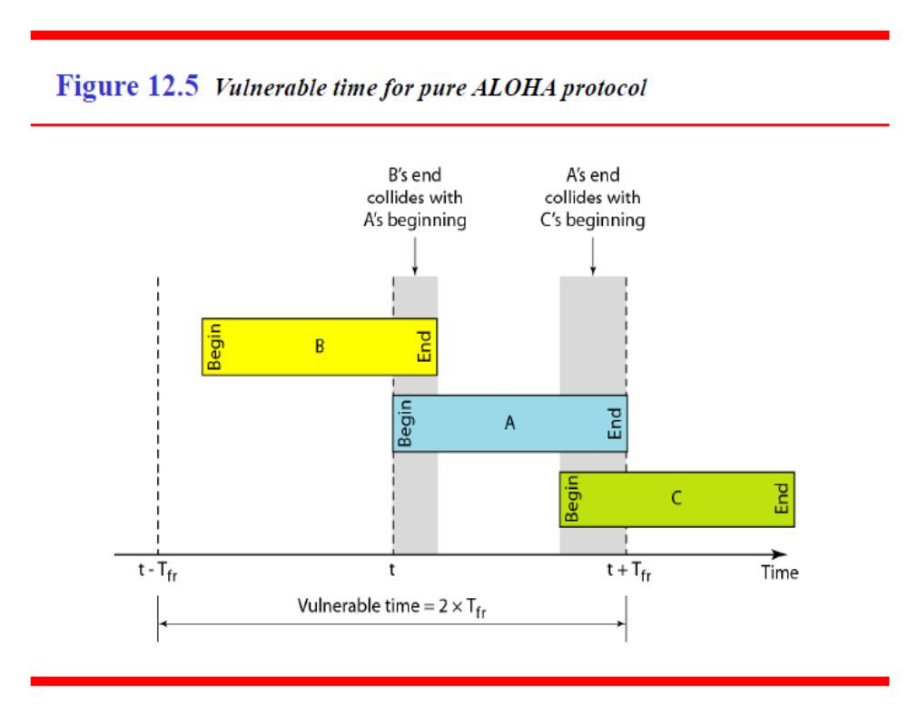
12.<number>

Slide 11
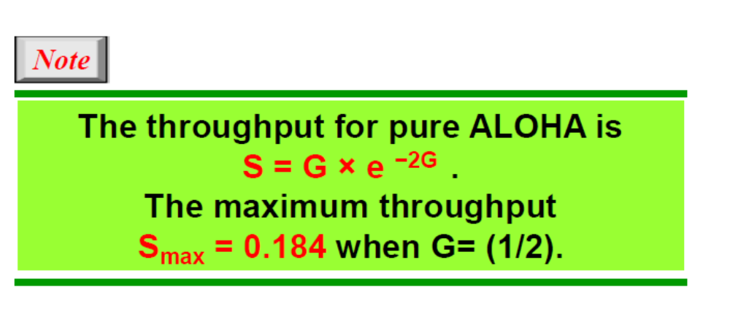
G is the average number of frames generated by the system during one frame transmission time.
12.<number>

Slide 12
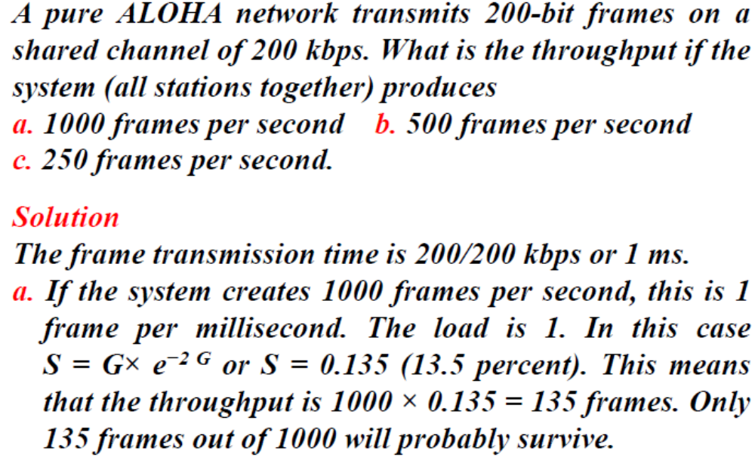
12.<number>

Slide 13
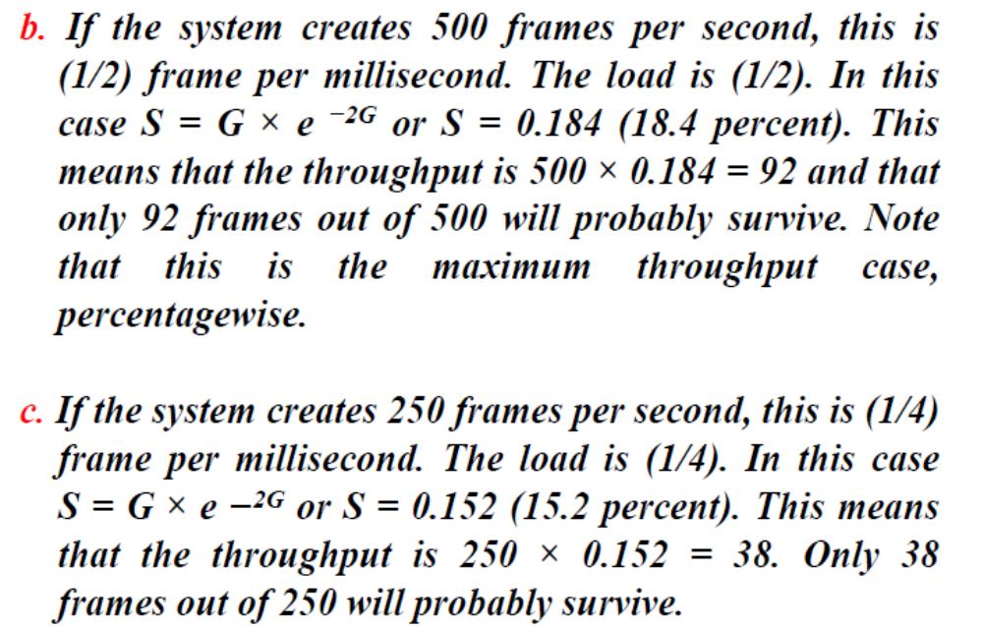
12.<number>

Slide 14

Figure 12.6 Frames in a slotted ALOHA network
12.<number>

Slide 15

Figure 12.7 Vulnerable time for slotted ALOHA protocol
12.<number>

Slide 16
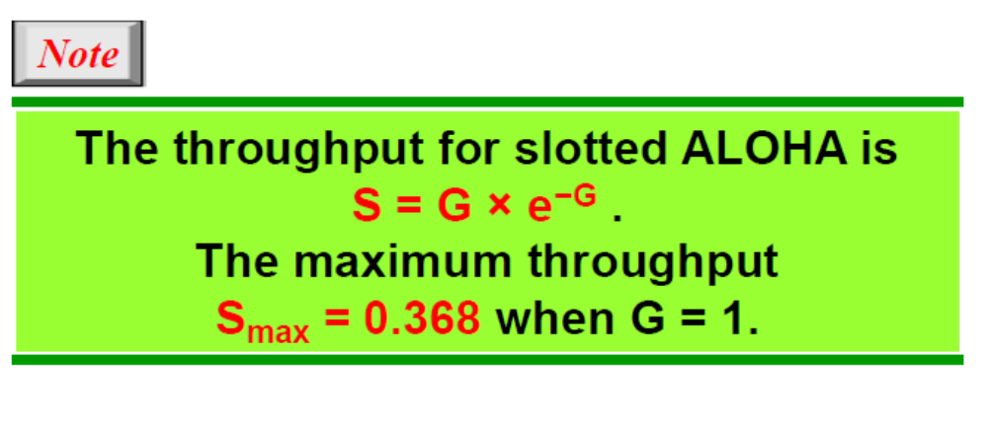
12.<number>

Slide 17
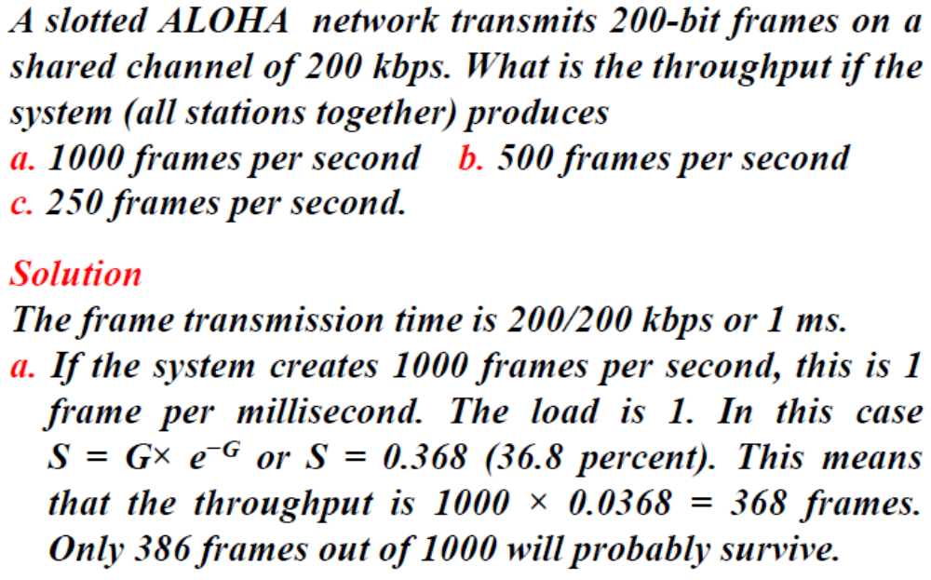
12.<number>

Slide 18
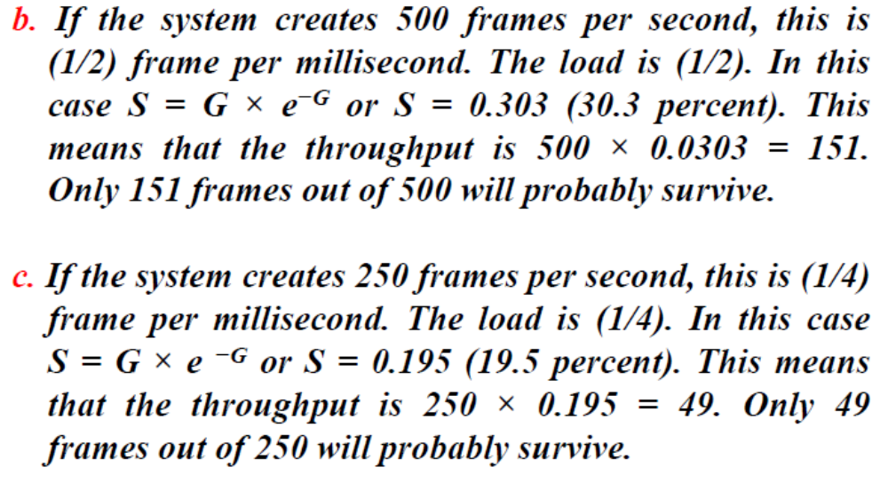
12.<number>

Slide 19
CSMA
Principle: each station first listen to the medium to check the state of the medium before sending.
“sense before transmit” or “listen before talk”
CSMA can reduce the possibility of collision, but it cannot eliminate it.
12.<number>

Slide 20

Figure 12.9 Vulnerable time in CSMA
12.<number>

Slide 21
Persistence Method
What should a station do if the channel is busy?
What should a station do if the channel is idle?
Three methods have been devised to answer these questions:
12.<number>

Slide 22
1-Persistent Method
After the station finds the line idle, it sends its frame immediately with probability 1.
Limitation
The method has the highest chance of collision, as two or more stations may find the line idle and send their frames immediately.
12.<number>

Slide 23
Non Persistent
A station that has a frame to send senses the line:
  If the line is idle, it sends immediately.
  If the line is not idle, it waits for a random amount of time and then senses the line again.
The non persistent approach reduces the chance of collision, because it is unlikely that two or more stations wait for same amount of time and retry to send simultaneously.
Limitation:
This method reduces the efficiency of the network because the
medium remain idle when there may be stations with frames to send.
12.<number>

Slide 24
p-Persistent
This method is used if the channel has time slots with a slot duration equal to or greater than the maximum propagation time.
The p-persistent approach combines the advantages of the other two strategies.
It reduces the chance of collision and improves efficiency.
12.<number>

Slide 25
In this method, after the station finds the line idle it follows these steps:
  (Step.1) With probability p, the station sends its frame.
  (Step.2) With probability q = 1 - p, the station waits for the beginning of the next time slot and checks the line again.
    a. If the line is idle, it goes to step 1.
    b. If the line is busy, it acts as though a collision has
    occurred and uses the back-off procedure.
12.<number>

Slide 26

Figure 12.10 Behavior of three persistence methods
12.<number>

Slide 27

Figure 12.11 Flow diagram for three persistence methods
12.<number>

Slide 28
CSMA/CD
In this method, a station monitors the medium after it sends a frame to see if
The transmission was successful.
If so, the station is finished.
If, however, there is a collision, the frame is sent again.
12.<number>

Slide 29

Figure 12.12 Collision of the first bit in CSMA/CD
12.<number>

Slide 30

Figure 12.13 Collision and abortion in CSMA/CD
12.<number>

Slide 31
Example 12.5
A network using CSMA/CD has a bandwidth of 10 Mbps. If the maximum propagation time (including the delays in the devices and ignoring the time needed to send a jamming signal, as we see later) is 25.6 μs, what is the minimum size of the frame?
Solution
The frame transmission time is T_{fr} = 2 × T_{p} = 51.2 μs. This means, in the worst case, a station needs to transmit for a period of 51.2 μs to detect the collision. The minimum size of the frame is 10 Mbps × 51.2 μs = 512 bits or 64 bytes. This is actually the minimum size of the frame for Standard Ethernet.
12.<number>

Slide 32

Figure 12.14 Flow diagram for the CSMA/CD
12.<number>

Slide 33
A 2 km long broadcast LAN has 10⁷ bps bandwidth and uses CSMA/CD. The signal travels along the wire at 2 × 10⁸ m/s. What is the minimum packet size that can be used on this network?
Consider a CSMA/CD network that transmits data at a rate of 100 Mbps (10⁸ bits per second) over a 1 km (kilometre) cable with no repeaters. If the minimum frame size required for this network is 1250 bytes, what is the signal speed (km/sec) in the cable?
A network with CSMA/CD protocol in the MAC layer is running at 1 Gbps over a 1 km cable with no repeaters. The signal speed in the cable is 2 x 10⁸ m/sec. The minimum frame size for this network should be
A network has a data transmission bandwidth of 20 × 10⁶ bits per second. It uses CSMA/CD in the MAC layer. The maximum signal propagation time from one node to another node is 40 microseconds. The minimum size of a frame in the network is _________ bytes.
12.<number>

Slide 34
The data rate is 10 Mbps, the distance between station A and C is 2000 m, and the propagation speed is 2 x 10⁸ m/s. Station A starts sending a long frame at time t1 =0µsec; station C starts sending a long frame at time t2 =3µsec.is. Assume the size of the frame is long enough to guarantee the detection of collision by both stations. Find:
A. The time when station C hears the collision (t3)
B. The time when station A hears the collision (t4)
C. The number of bits station A has sent before detecting the collision.
D. The number of bits station C has sent before detecting the collision.
12.<number>

